Slide 1
Pattern multiplication
SUBHASHRI S
2019105586

Slide 2
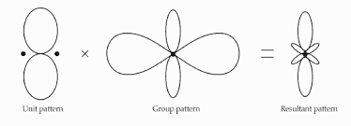
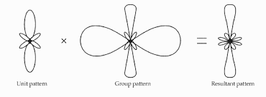
What is pattern multiplication?
The principle of pattern multiplication may be expressed as
“The total field pattern of an array of non-isotropic but
similar sources is the product of the individual source
pattern and the pattern of an array of isotropic
point sources each located at the phase center of the
individual source and having the same relative amplitude
and phase while the total phase pattern is the sum of the
phase patterns of the individual source and the array of
isotropic point sources.”

Slide 3
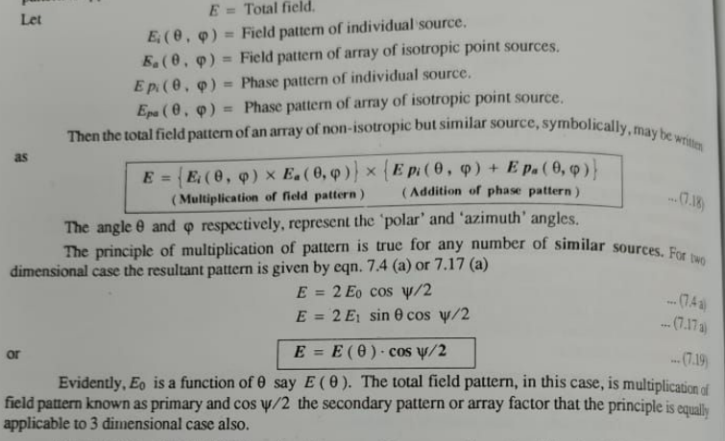

Slide 4
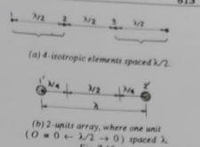
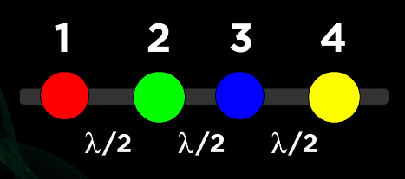
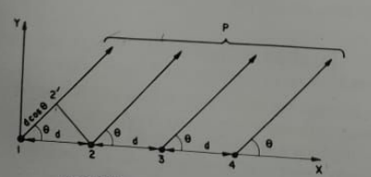
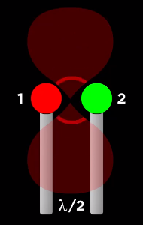
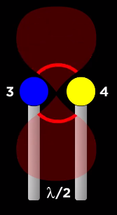
RADIATION PATTERN OF 4-ISOTROPIC ELEMENTS FED IN PHASE, spaced λ/2 apart:

Slide 5
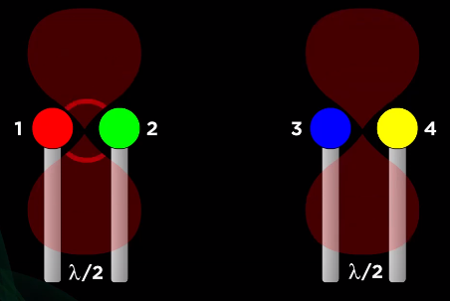
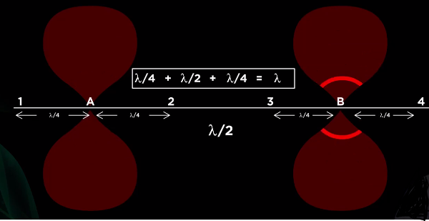
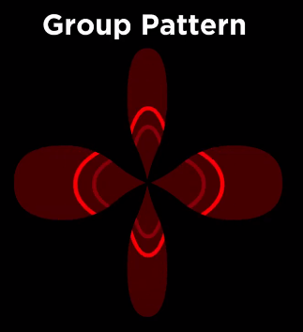
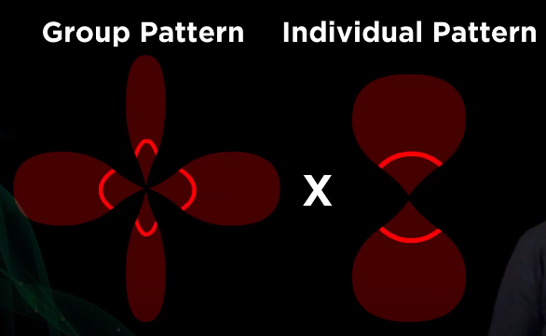

Slide 6
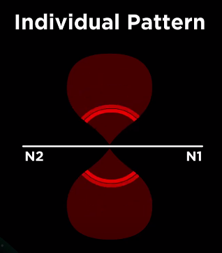
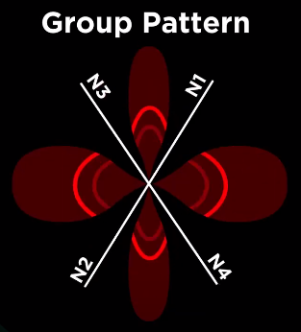
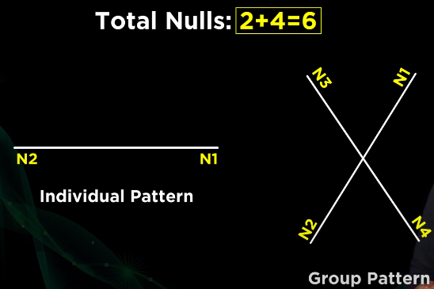
Nulls:
A null is a direction in an antenna’s radiation pattern where the antenna radiates almost no radio waves, so the far field strength is local minimum.

Slide 7
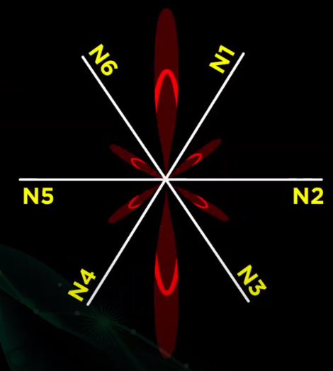
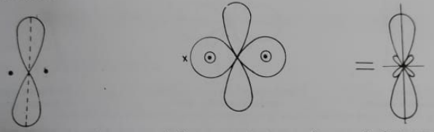
OUTPUT RADIATION PATTERN:

Slide 8
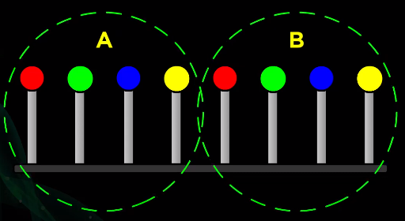
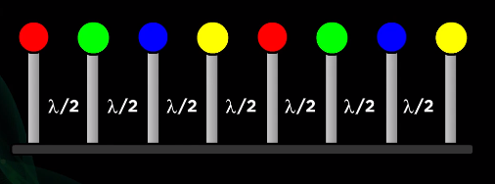
RADIATION PATTERN OF 8-ISOTROPIC ELEMENTS FED IN PHASE, spaced λ/2 apart:

Slide 9

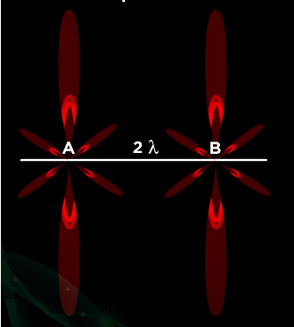


Slide 11
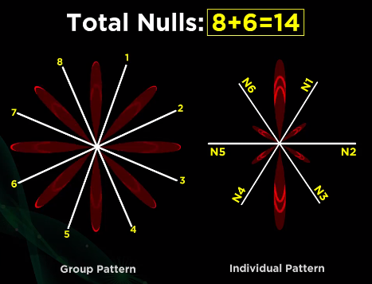
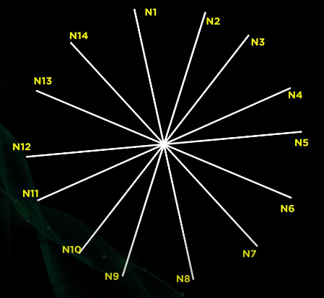
Nulls:

Slide 12
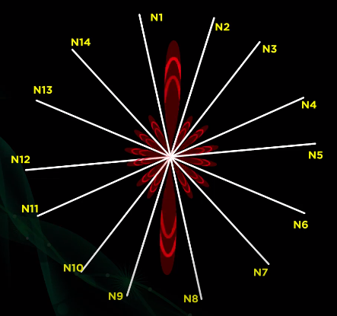
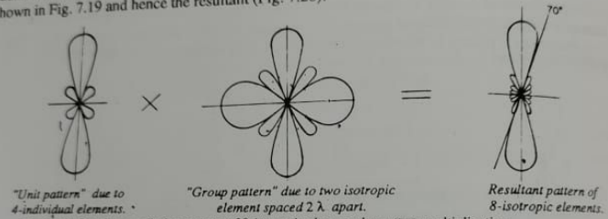
OUTPUT RADIATION PATTERN:

Slide 13
Advantages: DISADVANTAGES:
Speedy method for sketching the pattern of complicated arrays just by inspection
Useful tool in design of antenna arrays
Exact and point by point multiplication of patterns of the resultant
Only applicable for arrays containing similar/ identical elements.

Slide 14
THANK YOU!

